Slide 1



Customer Analysis
By: Sidhant Thakur, Parth Patel, Preetham Sai K, Sumera Khan, Saransh Thakur

Slide 2



Introduction
The goal of this report is to visualize the sales dataset so that the customer analysis can be performed. Our data set contains 286369 observations and 36 characteristics. Geographical, numerical, categorical, ordinal, and continuous variables are type of variable.

Slide 3
Data, Audience, Message
Data : 286369 observations and 36 attributes are included in this sales data collection.
Audience: The audience could be a marketing team or a research team.
Message: Using suitable charts to represent revenue based on a variety of variables, as well as evaluating graphs and deriving conclusions from them.

Slide 4

Application of Analysis
Revenue per state.
Revenue based on month of year.
Order status based on revenue.
Revenue based on Age
Quantity – Discount percentage correlation
Percentage of revenue per region
Revenue per category per gender
Orders per category by gender

Slide 5
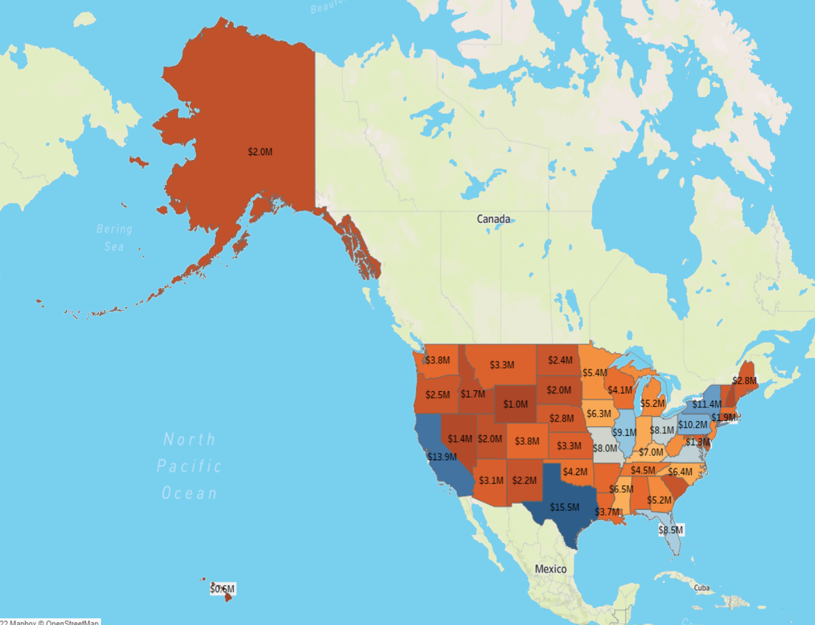
Revenue per state
Displays the revenue allocation by state. TX has the greatest revenue of $15.5 million, followed by California with $13.9 million. DC has the lowest revenue of $1.3 million.

Slide 6
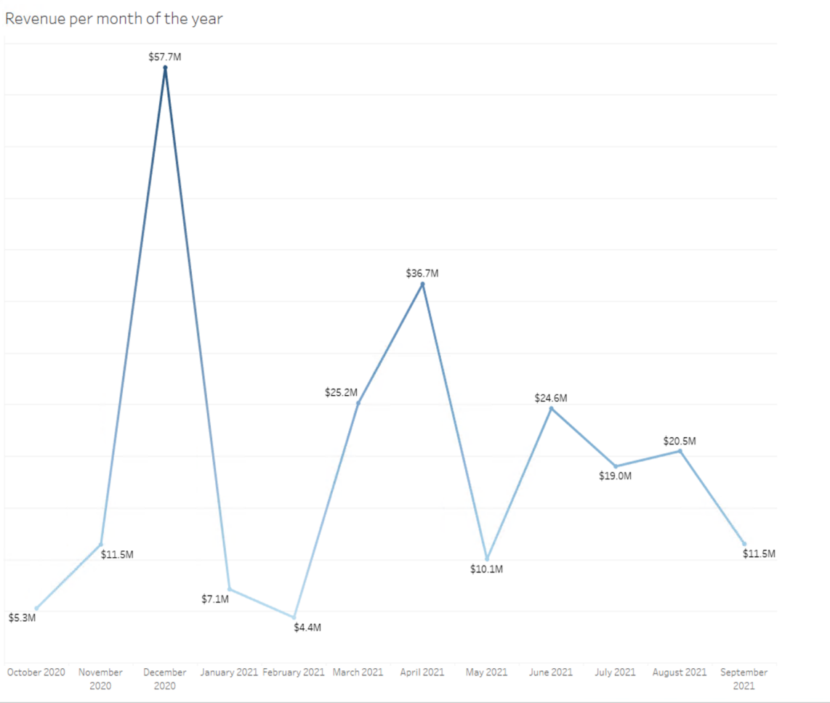
Revenue based on month of year
The month of December generates the most revenue ($57.7 million), while February generates the least revenue ($4.4 million). Revenue jumped by nearly 400% in November but fell by nearly 87% in January. Furthermore, from June to September, there is a downward trend.

Slide 7
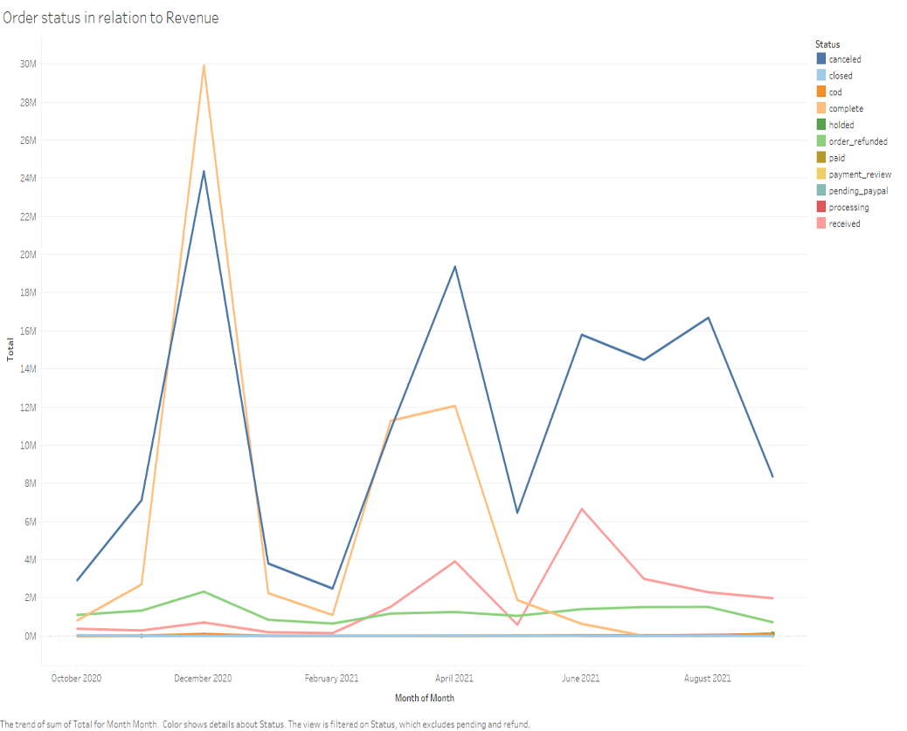
Order status based on revenue
Since November to December have the most orders completed, December has the most revenue.
As December to January has the highest number of orders canceled, there is a significant decrease in revenue.

Slide 8
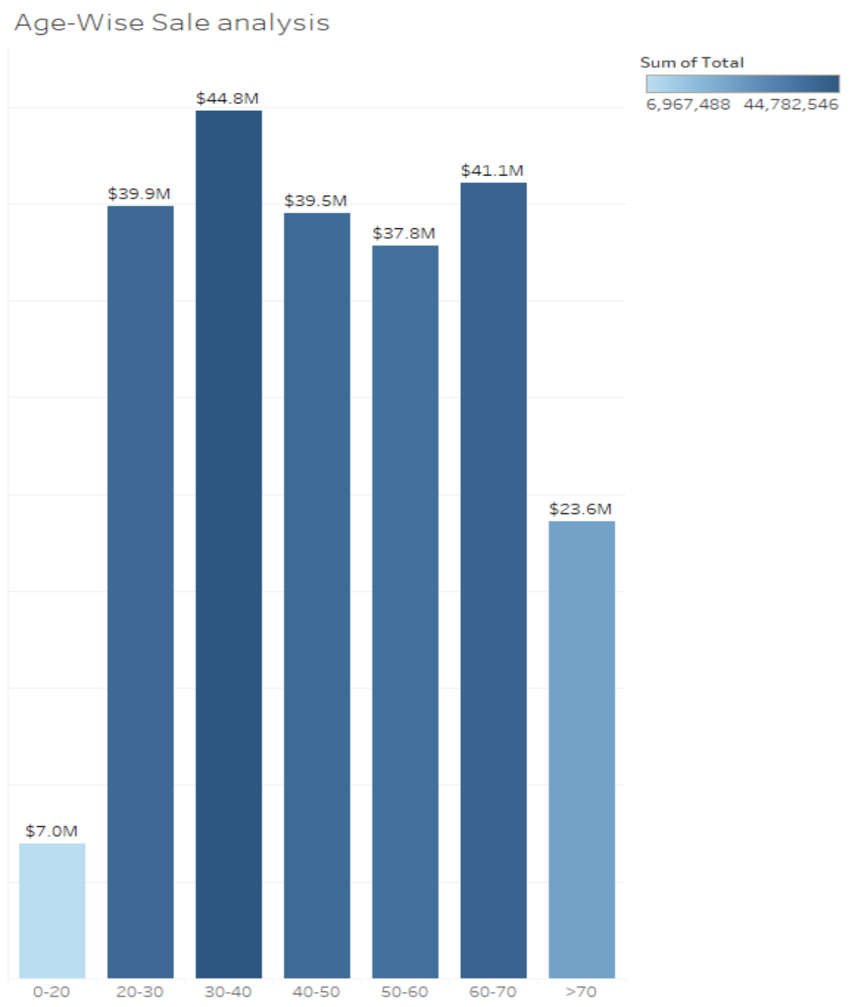
Revenue based on age
The 30-40 age group spent approximately 45 million, followed by the 60-70 age group, which spent 41 million.
The 0-20 age group, which spent 7 million.

Slide 9
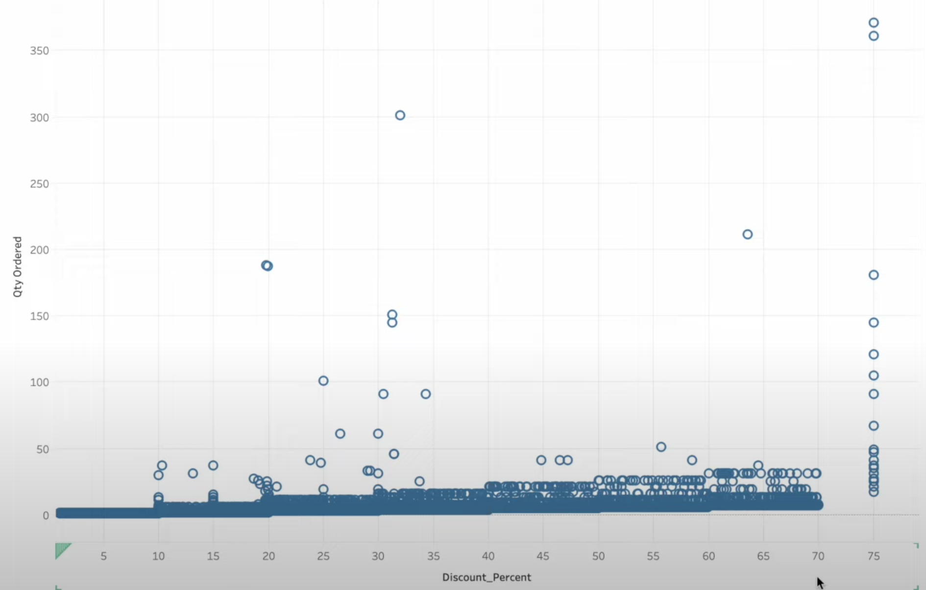
Quantity Discount correlation
As the discount percentage increases, so does the quantity order, and there is a positive correlation.
As a result, if the discount percentage is high, so is the quantity order.

Slide 10
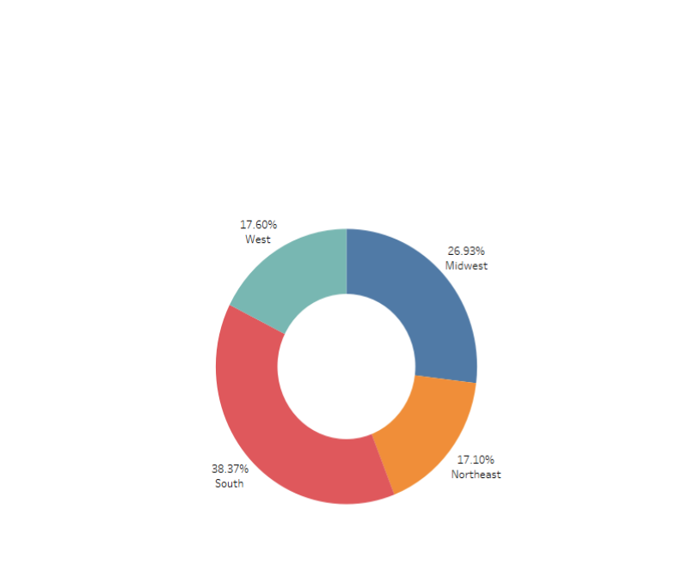
Percentage of revenue per region
The south region has the highest percentage of revenue with 38.37%, followed by the Midwest with 26.93%.
The Northeast region has the lowest revenue (17.10%).
Revenue percentage generated in the north and west are almost same nearly 17%.

Slide 11
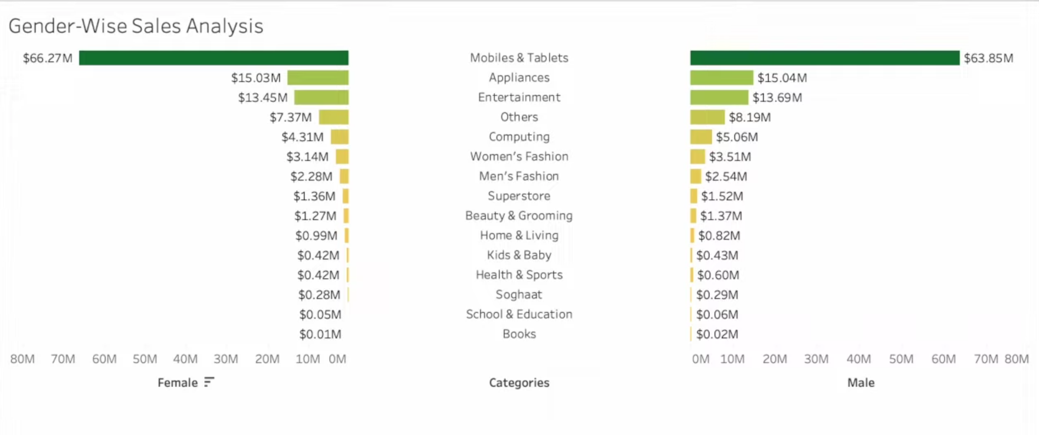
Revenue per category per gender
Women have spent up to $66 million, while men have spent up to $63 million.
Mobiles & Tablets have a significant impact on revenue, with female contributing to more than males.
Additionally, the money earned by the Appliances is approximately exactly $15 millions for both genders.

Slide 12
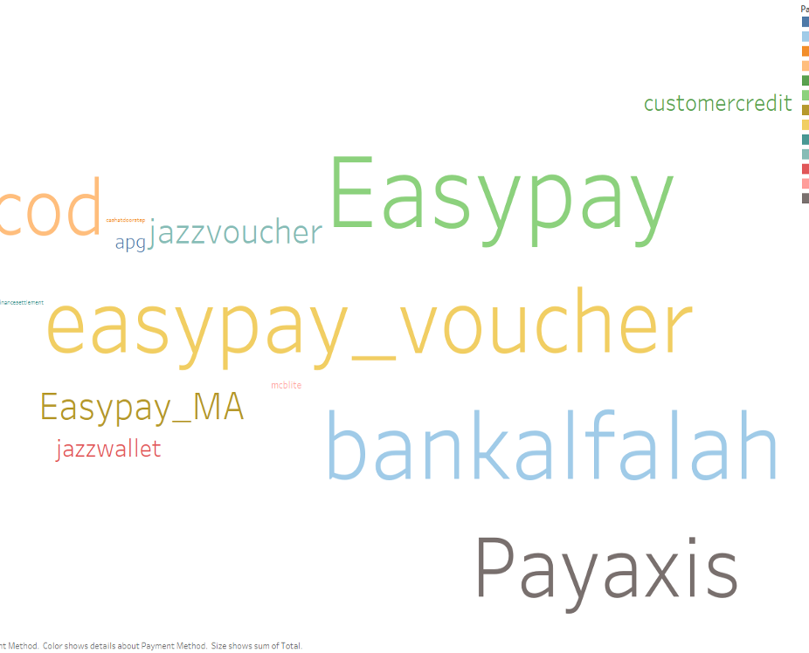
PAYMENT METHOD
Easy pay is the most popular payment method among customers, followed by bank alfalah.
The least popular payment method is cash at doorstep.

Slide 13
Thank you

